Slide 1
JDBC & DAO
Dao Huu Khanh
Oct 20 2018
Notes:
This file has been revised on June 11 2015 for more information.

Slide 2
Introduction
Your role
Your background and experience in the subject
What do you want from this course

Slide 3
Course Objectives
At the end of the course, you will have acquired sufficient knowledge to:
Understand connection that can be connect to any relational database
Create factory class switch to specific relational database
Be ready to retrieve, insert, update, delete database

Slide 4
Agenda
Introduction Java JDBC
Java Connectivity
5 steps to access and retrieve relational database
Structure of DAO

Slide 5
Course Audience and Prerequisite
Course Audience:
suitable for those who work on system information.
Also suitable for individuals need to access relational database.
Course pre-requisite:
Basic knowledge on relational Database. Understand ANSI SQL command
Professional on Java language

Slide 6
Assessment Disciplines
Class Participation: <100%>
Passing Scores: <70%>

Slide 7
JAVA JDBC
JDBC stands for Java Database
Java API to connect and execute the query with the database Connectivity
Using JDBC drivers to connect with the database
There are four types JDBC
JDBC-ODBC Bridge Driver
Native Driver
Network Protocol Driver
Thin Driver

Slide 8
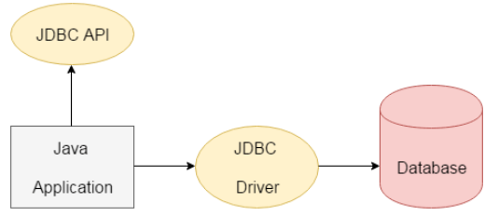
JAVA JDBC
The current version of JDBC is 4.3. Release since 21st September, 2017
The java.sql package contains classes and interfaces for JDBC API.

Slide 9
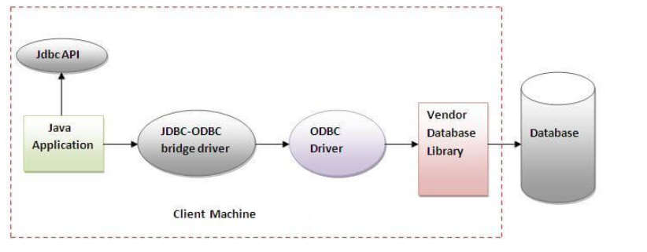
JAVA JDBC
DBC-ODBC bridge driver
Using ODBC driver to connect to the database. The JDBC-ODBC bridge driver converts JDBC method calls into the ODBC function calls

Slide 10
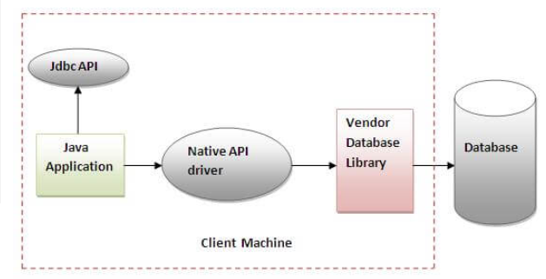
JAVA JDBC
Native-API driver
Using the client-side libraries of the database. The driver converts JDBC method calls into native calls of the database API

Slide 11
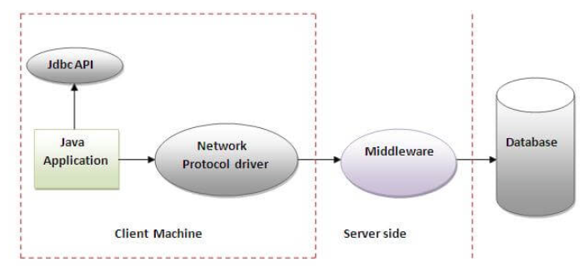
JAVA JDBC
3 Network Protocol driver
Using middleware (application server) that converts JDBC calls directly or indirectly into the vendor-specific database protocol

Slide 12
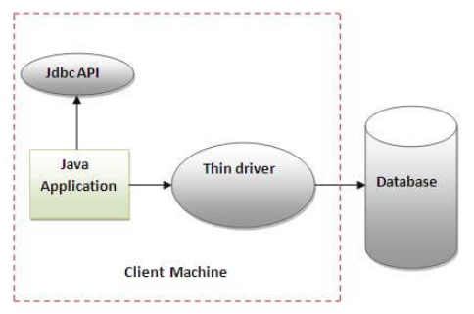
JAVA JDBC
4. Thin driver
converts JDBC calls directly into the vendor-specific database protocol. That is why it is known as thin driver

Slide 13
Java Database Connectivity
Java Database Connectivity request 4 mandatory items
Driver class: The driver class for the specific database
Connection URL: The connection URL is string combine database type, database server, port
User name: user name login into database
Password: It is the password given by the user on item #3

Slide 14
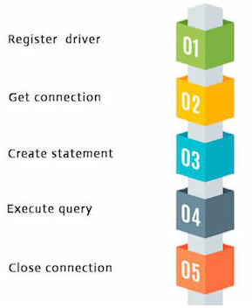
Java Connectivity
There are 5 steps to connect any java application with the database using JDBC
Register the Driver class
Create connection
Create statement
Execute queries
Close connection

Slide 15
Step 1: Register the driver class
The forName() method of Class class is used to register the driver class
public static void forName(String className)throws ClassNotFoundException
Ex: Class.forName("oracle.jdbc.driver.OracleDriver");

Slide 16
Step 2: Create Connection
The getConnection() method of DriverManager class is used to establish connection with the database.
Get one in two method getConnection of driver below
public static Connection getConnection(String url) throws SQLException
public static Connection getConnection(String url,String name,String password)
throws SQLException
Ex: Class.forName("oracle.jdbc.driver.OracleDriver");
Connection con=DriverManager.getConnection( "jdbc:oracle:thin:@localhost:1521:xe","system","password");

Slide 17
Step 3: Create the Statement
Is method of Connection interface is used to create statement. It is responsible to execute queries with the database. There are 3 ways to create statement Statement PreparedStatement CallableStatement

Slide 18
Step 3(cont): Statement
public Statement createStatement()throws SQLException
Ex: Statement stmt=con.createStatement();

Slide 19
Step 3(cont): PreparedStatement
public PreparedStatement prepareStatement(String query)throws SQLExceptio{}
If there are parameter ? On query, request to fill value for param ? by using method below
public void setInt(int paramIndex, int value)
public void setString(int paramIndex, String value)
public void setFloat(int paramIndex, float value)
public void setDouble(int paramIndex, double value)

Slide 20
Step 3(cont): CallableStatement
Used to call the stored procedures and functions.
public CallableStatement prepareCall("{ call procedurename(?,?...?)}")
If there are parameter ? On query, request to fill value for param ? by using method below
public void setInt(int paramIndex, int value)
public void setString(int paramIndex, String value)
public void setFloat(int paramIndex, float value)
public void setDouble(int paramIndex, double value)
public void registerOutParameter(parameterIndex, sqlType);
Ex:CallableStatement stmt=con.prepareCall("{call myprocedure(?,?)}")

Slide 21
Step 4: Execute the query
To execute queries to the database. Method execute query depend statement on step 2

Slide 22
Step 4(cont): Execute used for Statement
Method execute is use for statement
public ResultSet executeQuery(String sql): used to execute SELECT query. Returns ResultSet.
public int executeUpdate(String sql): used to execute for create, drop, insert, update, delete etc.
public boolean execute(String sql): used to execute queries that may return multiple results.
public int[] executeBatch(String sql): used to execute batch of commands.
Ex: ResultSet rs = stmt.executeQuery("select * from emp");

Slide 23
Step 4(cont): Execute used for PreparedStatement
Method execute is use for statement
public int executeUpdate(): executes the query used for create, drop, insert, update, delete etc.
public ResultSet executeQuery():executes the select query. It returns an instance of ResultSet.
Ex:
PreparedStatement stmt=con.prepareStatement("insert into Emp values(?,?)");
stmt.setInt(1,101);//1 specifies the first parameter in the query
stmt.setString(2,"Ratan");

Slide 24
Step 4(cont): Execute used for CallableStatement
Method execute is use for statement
public boolean execute(): executes the query not returning select SQL
public ResultSet executeQuery():executes the select query. It returns an instance of ResultSet.
Ex:
PreparedStatement stmt=con.prepareStatement("insert into Emp values(?,?)");
stmt.setInt(1,101);//1 specifies the first parameter in the query
stmt.setString(2,"Ratan");

Slide 25
Step 5: Close the connection
Closing connection object statement and ResultSet will be closed automatically
The close() method of Connection interface is used
public void close()throws SQLException
Ex: con.close();

Slide 26
Factory Method Pattern
Factory pattern is apply to develop connection to database.
It is able to solve problem switch to one in multi database without modify connection
We create object without exposing the creation logic by refer to newly created multi objects using a common interface.

Slide 27
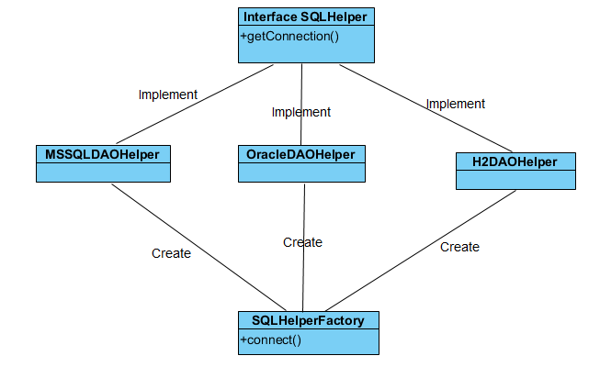
Factory Method Pattern - Implementation

Slide 28
Factory Method Pattern - Implementation
Step 1
Create an interface SQLHelper.java
public interface Smart400SQLHelper {
public Connection getConnection();
}

Slide 29
Factory Method Pattern - Implementation
Step 2
Create concrete classes implementing the same interface.
public class MSSQLDAOHelperImpl implements SQLHelper {
public Connection getConnection() {
}
}
public class OracleDAOHelperImpl implements Smart400SQLHelper {
public Connection getConnection() {
}
}

Slide 30
Factory Method Pattern - Implementation
Step 3
Create a Factory class <SQLHelperFactory> to generate object of concrete class based on given information.
public class SQLHelperFactory {
public static Connection connect() {
SQLHelper sqlHelper = null;
String type →<get from config properties>
if (type.equals(“ORACLE"))
sqlHelper = new OracleDAOHelperImpl();
else if (type.equals("MSSQL"))
sqlHelper = new MSSQLDAOHelperImpl();
else if (type.equals("H2"))
sqlHelper = new H2DAOHelperImpl();
Connection connection = sqlHelper.getConnection();
}

Slide 31
Question for JDBC and connectivity?

Slide 32
Exercise
Create class H2DAOHelperImpl that create connection database H2

Slide 33
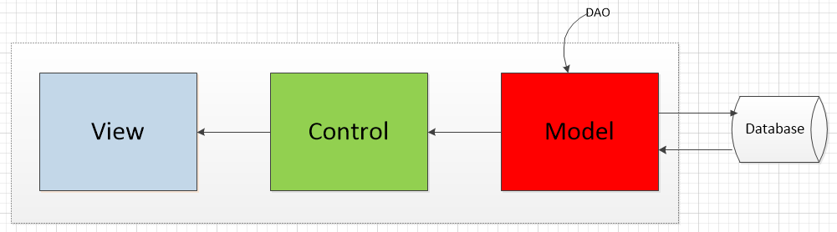
Data Access Object
Data Access Object Pattern or DAO pattern is used to separate low level data accessing API or operations from high level business services. Following are the participants in Data Access Object Pattern.

Slide 34
Data Access Object
Data Access Object Interface - This interface defines the standard operations to be performed on a model object(s). Data Access Object concrete class - This class implements above interface. This class is responsible to get data from a data source which can be database / xml or any other storage mechanism. Model Object or Value Object - This object is simple POJO containing get/set methods to store data retrieved using DAO class.

Slide 35
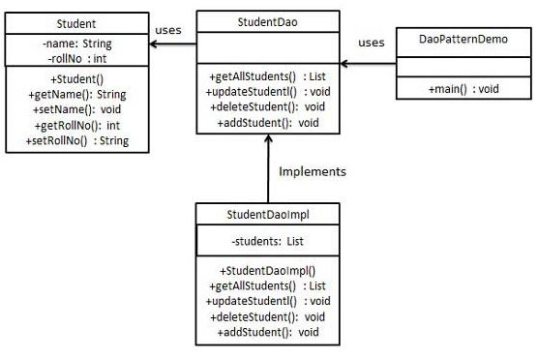
Implement

Slide 36
Sample Integral – POJO, Interface
public class Student { private String name; private int id; Student(int id, String name){ this.name = name; this.id = id; } public String getName() { return name; } public void setName(String name) { this.name = name; } public int getId() { return id; } public void setId(int id) { this.id = id; } } | public interface StudentDao { public List<Student> getAllStudents(Connection conn); public Student getStudent(int rollNo, Connection conn); public void insertStudent(Student student, Connection conn); public void updateStudent(Student student, Connection conn); public void deleteStudent(int id, Connection conn); public void deleteStudents(Connection conn); public void createTableStudent(Connection conn); public void dropTableStudent(Connection conn); }

Slide 37
Sample Integral – implements DAO
public class StudentDaoImpl implements StudentDao { List<Student> students; public List<Student> getAllStudents(Connection conn) { List<Student> students = new ArrayList<Student>(); String selectSQL = "SELECT id, name FROM student"; try { PreparedStatement preparedStatement = conn.prepareStatement(selectSQL); ResultSet rs = preparedStatement.executeQuery(); while (rs.next()) { String username = rs.getString("name"); int id = rs.getInt("id"); Student student = new Student(id,username); students.add(student); } catch (SQLException e) { e.printStackTrace(); } return students; } | public void insertStudent(Student student, Connection conn) { String tableSQL = "INSERT INTO student" + "(id, name) VALUES (?,?)"; try { PreparedStatement preparedStatement = conn.prepareStatement(tableSQL); preparedStatement.setInt(1, student.getId()); preparedStatement.setString(2, student.getName()); preparedStatement.executeUpdate(); } catch (SQLException e) { System.out.println(e.getMessage()); } }

Slide 38
Sample Integral – call DAO
import com.csc.group.agents.dataaccess.Zablistpf;
import com.csc.smart400framework.dataaccess.SmartFileCode;
import com.csc.smart400framework.parent.SMARTCodeModel;
import com.csc.group.agents.dataaccess.dao.ZablistpfDAO;
public class Pr267aa4 extends SMARTCodeModel {
private ZablistpfDAO zablistpfDAO = getApplicationContext().getBean("zablistpfDAO",
ZablistpfDAO.class);
private List<Zablistpf> zablistpfList = new ArrayList<Zablistpf>();
protected void initialise1010(){
zablistpfList=zablistpfDAO.readZablistpf(agntIO.getAgntnum().toString());
}
}

Slide 39
Exercise
Create pojo Student : properties id, name
Create interface StudentDao: method
public List<Student> getAllStudents(Connection conn);
public void Student getStudent(int rollNo, Connection conn);
public void insertStudent(Student student, Connection conn);
public void updateStudent(Student student, Connection conn);
public void deleteStudent(int id, Connection conn);
public void deleteStudents(Connection conn);
Create class StudentDaoImpl implement StudentDao: overwrite method above
Create class DaoPatternDemo : create main(String[] args) that create connection to DB h2 and call method above
Notes:
public class Student {
private String name;
private int id;
Student(){
}
Student(int id, String name){
this.name = name;
this.id = id;
}
public String getName() {
return name;
}
public void setName(String name) {
this.name = name;
}
public int getId() {
return id;
}
public void setId(int id) {
this.id = id;
}
}
/////////////////////////////////////////////
import java.sql.Connection;
import java.util.List;
public interface StudentDao {
public List<Student> getAllStudents(Connection conn);
public Student getStudent(int rollNo, Connection conn);
public void insertStudent(Student student, Connection conn);
public void updateStudent(Student student, Connection conn);
public void deleteStudent(int id, Connection conn);
public void deleteStudents(Connection conn);
}
/////////////////////////////////////////
import java.sql.Connection;
import java.sql.PreparedStatement;
import java.sql.ResultSet;
import java.sql.SQLException;
import java.util.ArrayList;
import java.util.List;
public class StudentDaoImpl implements StudentDao {
List<Student> students;
@Override
public void deleteStudent(int id, Connection conn) {
String tableSQL = "DELETE student where id = ?";
try {
PreparedStatement preparedStatement = conn.prepareStatement(tableSQL);
preparedStatement.setInt(1, id);
// execute insert SQL statement
preparedStatement.executeUpdate();
System.out.println("Record student with id = " + String.valueOf(id) + " is deleted!");
} catch (SQLException e) {
System.out.println(e.getMessage());
}
}
@Override
public List<Student> getAllStudents(Connection conn) {
List<Student> students = new ArrayList<Student>();
String selectSQL = "SELECT id, name FROM student“;
try {
PreparedStatement preparedStatement = conn.prepareStatement(selectSQL);
ResultSet rs = preparedStatement.executeQuery();
while (rs.next()) {
String username = rs.getString("name");
int id = rs.getInt("id");
Student student = new Student(id,username);
students.add(student);
}
for(Student student : students)
System.out.println("Record id = " + String.valueOf(student.getId()) + ", name = " + student.getName());
}
catch (SQLException e) {
// TODO Auto-generated catch block
e.printStackTrace();
}
return students;
}
@Override
public Student getStudent(int id, Connection conn) {
Student student = null;
String selectSQL = "SELECT id, name FROM student WHERE id = ?";
try {
PreparedStatement preparedStatement = conn.prepareStatement(selectSQL);
preparedStatement.setInt(1, id);
ResultSet rs = preparedStatement.executeQuery();
if (rs.next()) {
String username = rs.getString("name");
student = new Student(id,username);
}
System.out.println("Record id = " + String.valueOf(id) + ", name = " + student.getName());
}
catch (SQLException e) {
// TODO Auto-generated catch block
e.printStackTrace();
}
return student;
}
@Override
public void updateStudent(Student student,Connection conn) {
String tableSQL = "UPDATE student set name = ? where id = ?";
try {
PreparedStatement preparedStatement = conn.prepareStatement(tableSQL);
preparedStatement.setString(1, student.getName());
preparedStatement.setInt(2, student.getId());
// execute insert SQL statement
preparedStatement.executeUpdate();
System.out.println("Record id = " + String.valueOf(student.getId()) + ", name = " + student.getName() + " is updated into Student table!");
}
catch (SQLException e) {
System.out.println(e.getMessage());
}
}
@Override
public void insertStudent(Student student, Connection conn) {
String tableSQL = "INSERT INTO student (id, name) VALUES (?,?)";
try {
PreparedStatement preparedStatement = conn.prepareStatement(tableSQL);
preparedStatement.setInt(1, student.getId());
preparedStatement.setString(2, student.getName());
// execute insert SQL stetement
preparedStatement.executeUpdate();
System.out.println("Record id = " + String.valueOf(student.getId()) + ", name = " + student.getName() + " is inserted into Student table!");
}
catch (SQLException e) {
System.out.println(e.getMessage());
}
}
@Override
public void deleteStudents(Connection conn) {
String tableSQL = "DELETE student";
try {
PreparedStatement preparedStatement = conn.prepareStatement(tableSQL);
// execute insert SQL statement
preparedStatement.executeUpdate();
System.out.println("All Record of students are deleted!");
}
catch (SQLException e) {
System.out.println(e.getMessage());
}
}
}

Slide 40
Questions & Answer
Notes:
Checking multi browsers
Format code in HTML and CSS (Ctrl + K + D)
Comments in coding
Align elements

Slide 41
Thank you and do you have any questions?

